Slide 1









Orchestrate Redshift ETL workflow using Glue and Step Functions
Its very common to use Redshift as data-warehousing tool in AWS cloud. However, there are quite some ways to orchestrate the loading/unloading/querying Redshift. In this solution, we will use in-house AWS tools to orchestrate end-to-end loading and deriving business insights. Since it uses in-house tools, availability and durability of the solution is guaranteed by AWS
The state machine launches a series of runs of an AWS Glue Python Shell job with parameters for retrieving database connection information from AWS Secrets Manager and an .sql file from S3.
Each run of the AWS Glue Python Shell job uses the database connection information to connect to the Amazon Redshift cluster and submit the queries contained in the .sql file.
For Task 1: The cluster utilizes Amazon Redshift Spectrum to read data from S3 and load it into an Amazon Redshift table. For Task 2: The cluster executes an aggregation query and exports the results to another Amazon S3 location via UNLOAD.
The state machine may send a notification to an Amazon Simple Notification Service (SNS) topic in the case of pipeline failure.
Users can query the data from the cluster and/or retrieve report output files directly from S3/Redshift using Quicksight
Users
Redshift

Slide 2

What?
Fully managed, petabyte-scale cloud data warehouse service. It also includes Redshift Spectrum that runs SQL queries directly against structured or unstructured data in Amazon S3 without loading them into Redshift cluster.
Why?
Redshift lets us run complex, analytic queries against structured data and semi-structured data, using sophisticated query optimization, columnar storage on high-performance storage like SSD, and massively parallel query execution.
Where?
AWS cloud based OLAP solution to store petabytes of information without owning infrastructure(Paas)
How?
We can connect via AWS CLI, AWS SDK, APIs, console

Slide 3

What?
A workflow(or State Machine) of steps(or tasks) where the output of one step acts as an input to the next. Each step in an application executes in order, as defined by business logic.
Why?
With its built-in operational controls, Step Functions manages sequencing, error handling, retry logic, state management, parameter passing removing a significant operational burden from developers.
Where?
Mobile Apps management. Ex) Uber, Zomato, FoodPanda apps where right from order placement till order dispatch happens in sequence of steps. User’s new request-> check User’s details(for pending payment, authenticity)->check for nearby service riders->check with restaurant for food availability->Place an order and assign a rider->Close the order->Feedback
How?
We can connect via AWS CLI, AWS SDK, APIs, Console

Slide 4

What?
A serverless data integration service that makes it easy to discover, prepare, and combine data for analytics, machine learning, and application development.
Why?
Run Spark/Python code without managing Infrastructure at nominal cost. You pay only during run time of the job. Also pay storage cost for Data Catalog objects
Where?
Glue can automatically discover both structured and semi-structured data stored in your data lake on Amazon S3, data warehouse in Amazon Redshift, and various databases running on AWS/on-premises using JDBC. It provides a unified view of your data via the Glue Data Catalog that is available for ETL, querying and reporting using services like Amazon Athena, Amazon EMR, and Amazon Redshift Spectrum.
How?
We can connect via AWS CLI, AWS SDK, APIs, Console

Slide 5

What?
Amazon Simple Notification Service is a notification service provided as part of Amazon Web Services since 2010. It provides a low-cost infrastructure for the mass delivery of messages, predominantly to mobile users
Why?
Out of the box solution with low operational overhead to deliver notifications via following endpoints
HTTP/HTTPS
Email/Email-JSON
Amazon Kinesis Data Firehose
Amazon SQS
AWS Lambda
Platform application endpoint
SMS
Where?
In Alarming applications
How?
We can connect API/SDK/CLI calls, console

Slide 6

What?
Amazon QuickSight is a scalable, serverless, embeddable, machine learning-powered business intelligence (BI) service built for the cloud.
Why?
The first BI service to offer pay-per-session pricing, where you only pay when your users access their dashboards or reports, making it cost-effective for large scale deployments. It can connect to wide variety of sources like Redshift, S3, Dynamo, RDS, files like JSON, text,csv, tsv, etc, jira, salesforce and on-premise oracle, sqlserver
Where?
A visualization Paas tool available in AWS. It supports wide variety of charts like bar, pie, donut, scatterplot, heatmap, treemap, etc. It also has Autograph where Quicksight will pick a chart category based on columns chosen and theirdata format
How?
We can control users access via IAM integration or adding users directly in Quicksight Console

Slide 7
Redshift
Create “mydemocluster” as redshift cluster name after creating “Subnet Group” from Config tab.
Note: Choose default database name as “reviews” instead of “dev”. Else you have to run CREATE DATABASE reviews after cluster creation.
Make a note of admin/master user name and password
Click on Editor(on left below Clusters)->Connect to Database->Create New Connection->Store the secret in Secrets Manager->key in your cluster details->Give a name for the secret
Check the secrets manager for redshift secret. Use this secret as “db_creds” parameter in glue job
Important Link: https://repost.aws/knowledge-center/redshift-resolve-access-denied-errors
S3
Create a new S3 bucket “mydemobucket<junk numbers> and create 2 folders: python, sql
Upload following files from project resources section in the same hierarchy:
python
rs_query.py
redshift_module-0.1-py3.6.egg
sql
reviewsschema.sql
topreviews.sql
etl.sql

Slide 8
Glue
A connection in Glue Console pointing to “mydemocluster” and test the connection using “mygluerole” role. Check the policies if the connection fails
Create a new job using “Python Shell” option(with python 3.6) and choosing rs_query.py(as source file), *.egg file (as python dependency file) and use the following job parameters:
--file sql/reviewsschema.sql (from step 2 in S3)
--db_creds redshiftqueryeditor-awsuser-myredshiftsecret (from step 4 in Redshift)
--db reviews (from step 1 in Redshift)
--bucket mydemobucket<junk numbers> (from step 2 in S3)
Select the connection created in step 1 for connecting to Redshift cluster
Run the job manually
Check the logs for any issues. Ensure to re-check the parameters for any naming issue

Slide 9
SNS
Create a Standard Simple Notification Service(SNS) named “alarm-topic” and copy the arn from topic dashboard page
Create a subscription to SNS topic by adding your email-id and “EMAIL” as option
Accept subscription request by logging into your email account. Only then you will start receiving messages
Step Functions
Create a state machine and copy paste state_machine.json(in project resources) and save the definition using “Myproject_StepFunction” name
Update the definition with the parameter values similar to your succeeded Glue job except for “file” parameter
Update the SNS arn to your SNS topic arn (Step 1 from SNS)
Attach the “myproject_stepfunctionsrole” role to state machine (step 3 from IAM)
Click “Start Execution” button and check out the job status
Ensure Glue manual run succeeded before coming to this step. Then ensure policy and parameters in the state machine definition is correct as per your environment(Choose “Edit Definition” to alter the JSON file any time you want.

Slide 10
Quicksight
Activate Quicksight subscription under “Standard” edition
Choose the same region as your S3 account by clicking on right top corner Account name dropdown
Choose Manage Quicksight(right top corner Account name dropdown)-> Choose S3 bucket that you want to connect to
Click on “Create Dataset” and add “S3” and upload the manifest.json(in project resources by altering the name of the file according to your extract in rmydemobucket<junk numbers>
Click on Analysis-> create a new one-> add “Add Visuals” on top left to add more charts and populate it by dragging and dropping corresponding column names

Slide 11
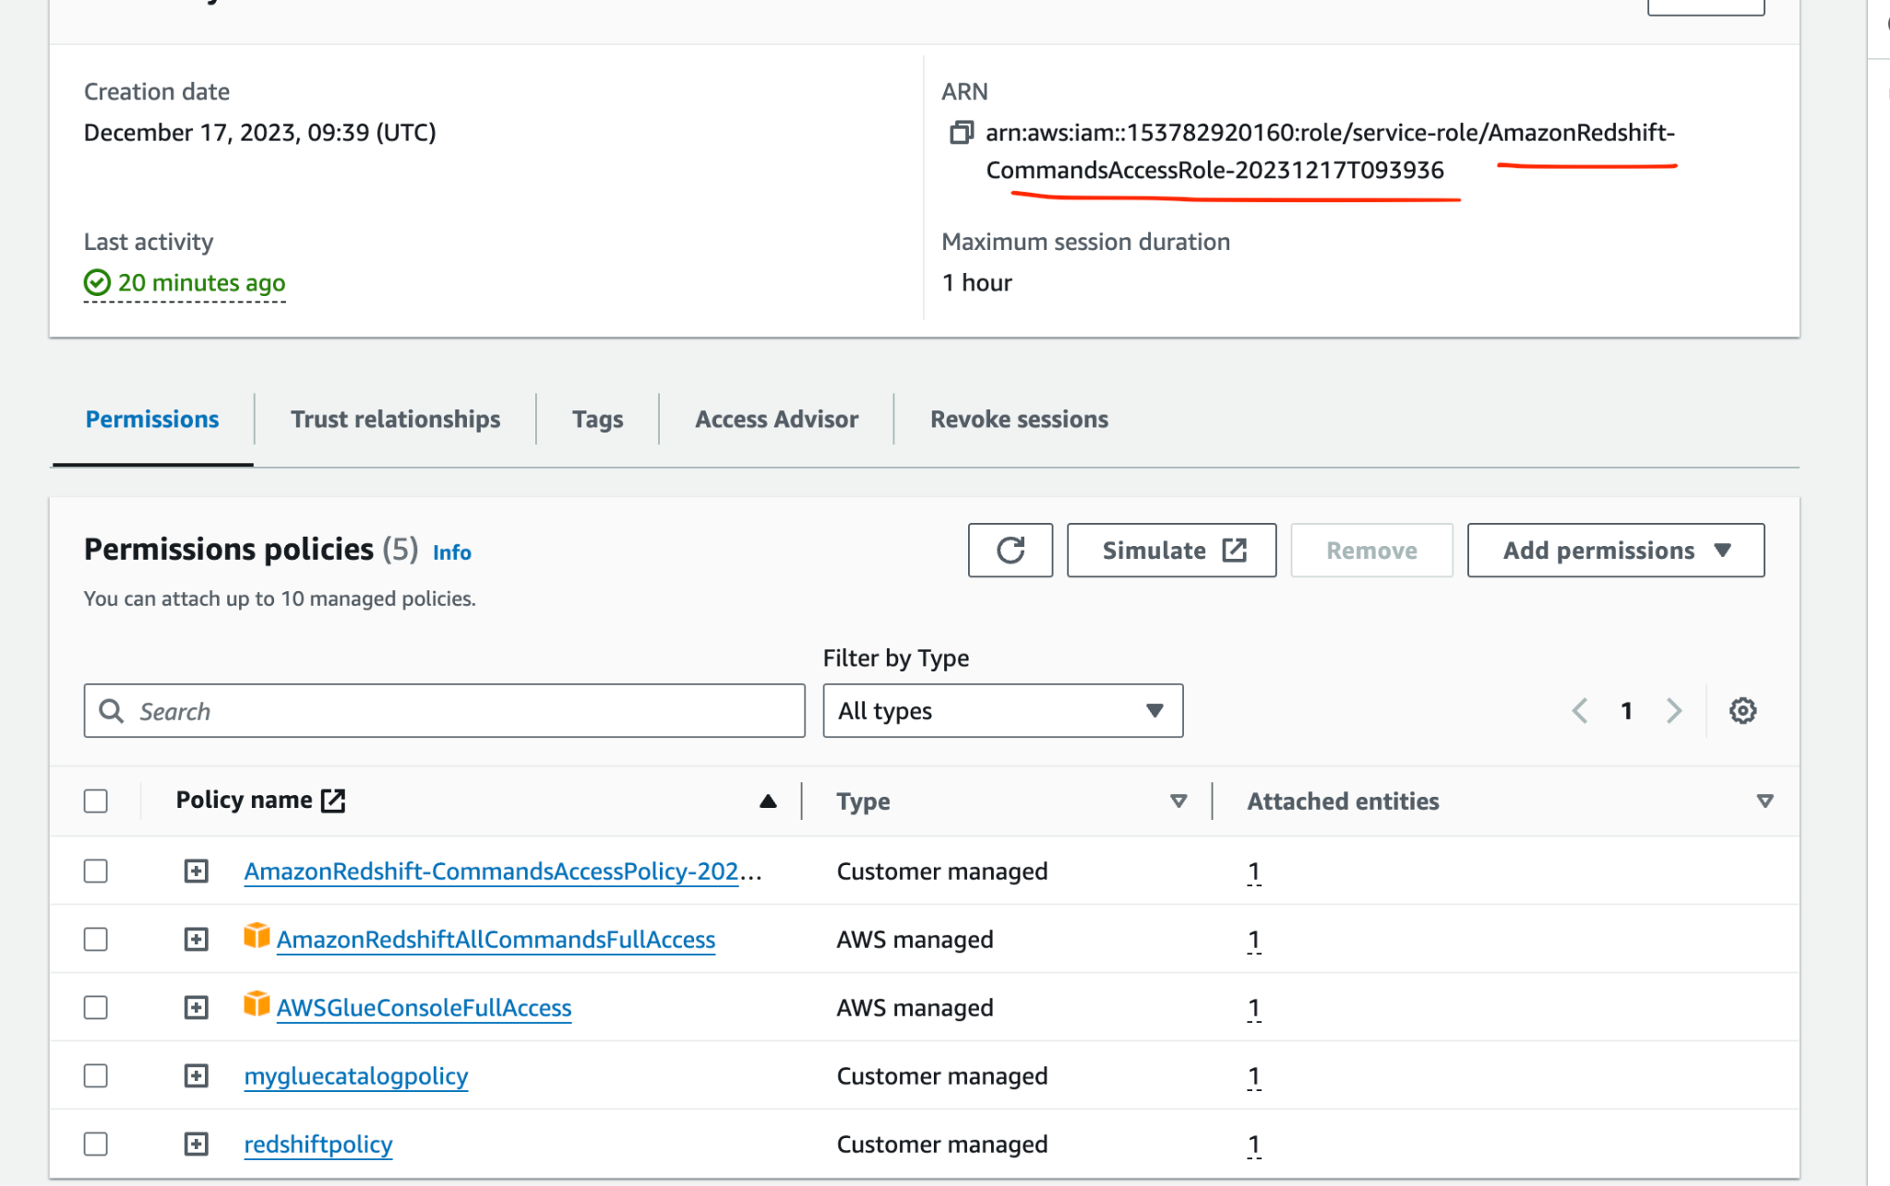
IAM Screenshots(for reference)

Slide 12
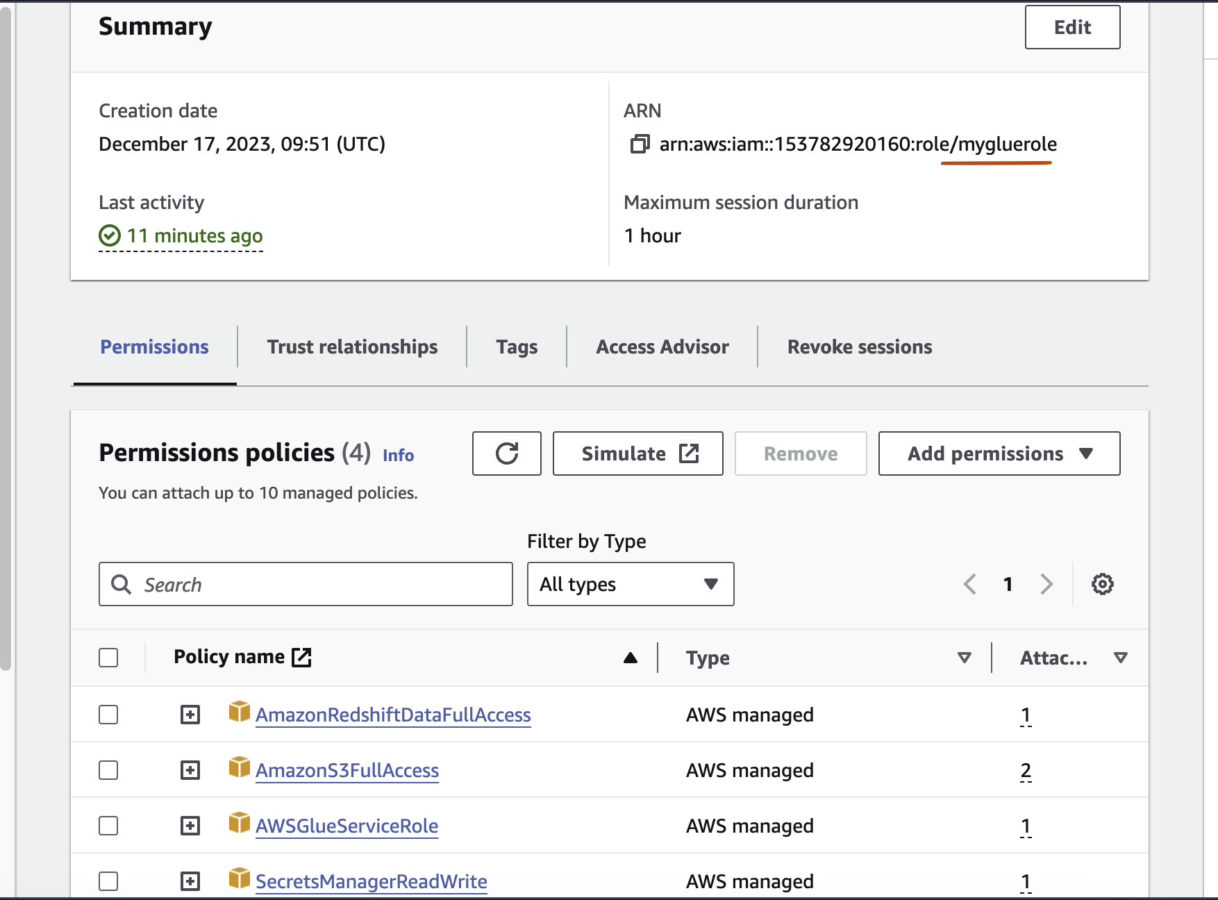
IAM Screenshots(for reference)

Slide 13
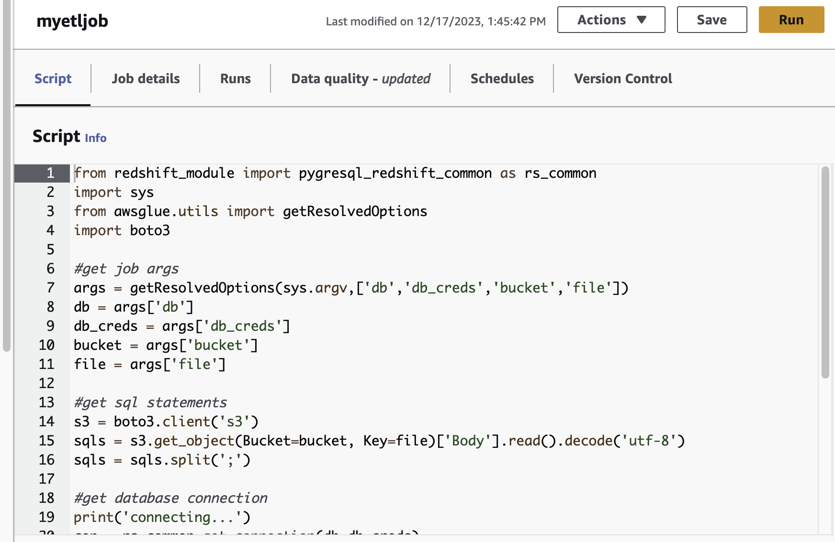
Glue Screenshots(for reference)

Slide 14
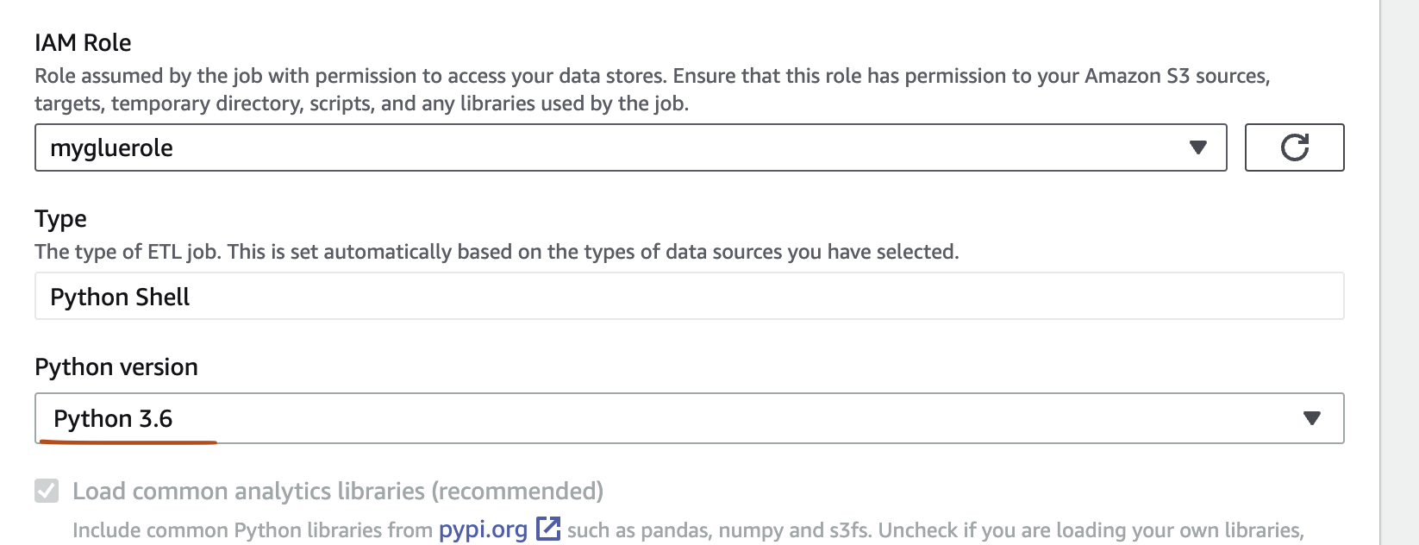

Slide 15
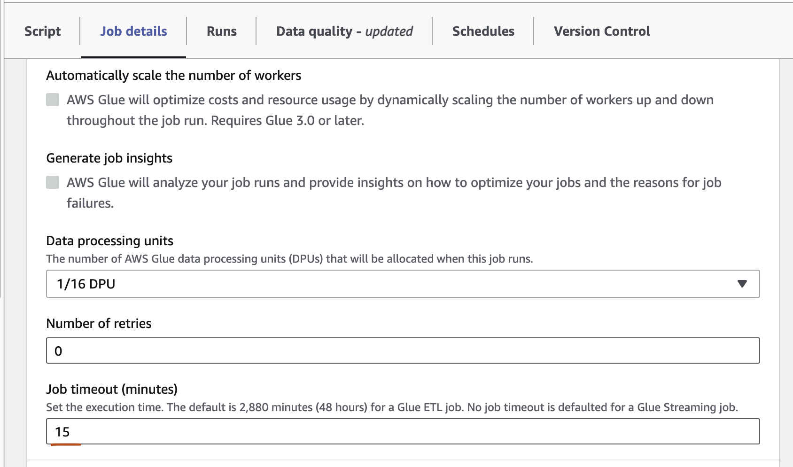

Slide 16
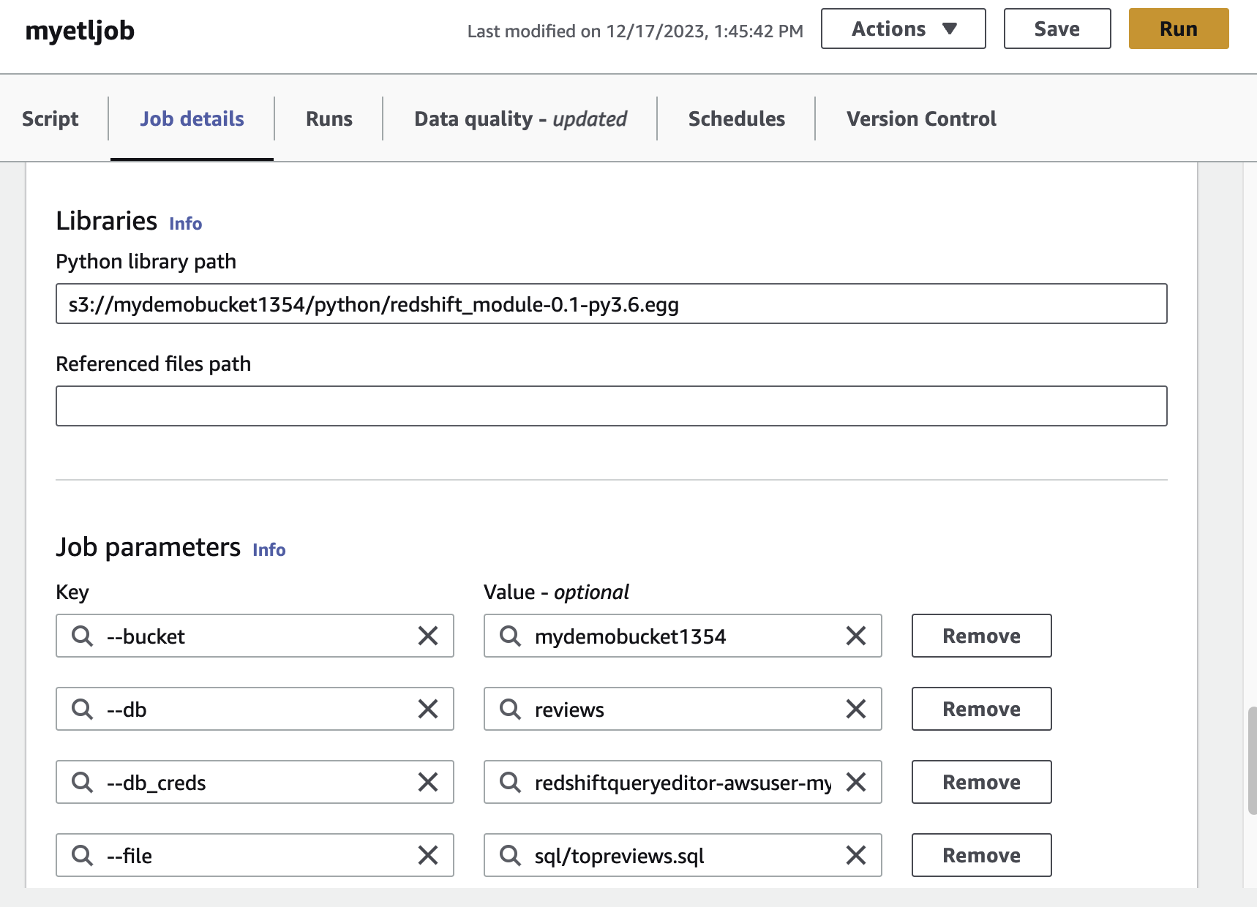

Slide 17
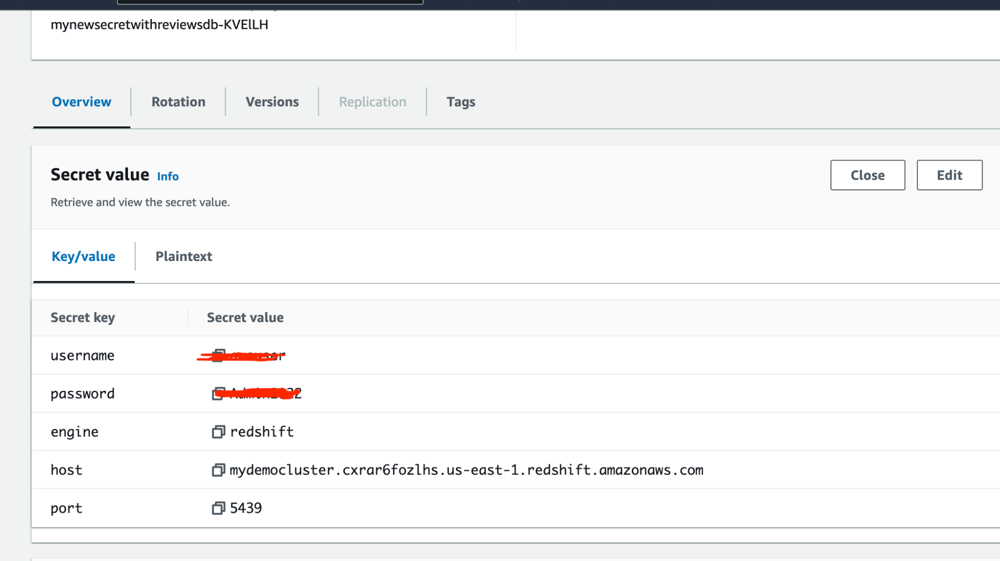
Secrets Manager screenshot(for reference)

Slide 18
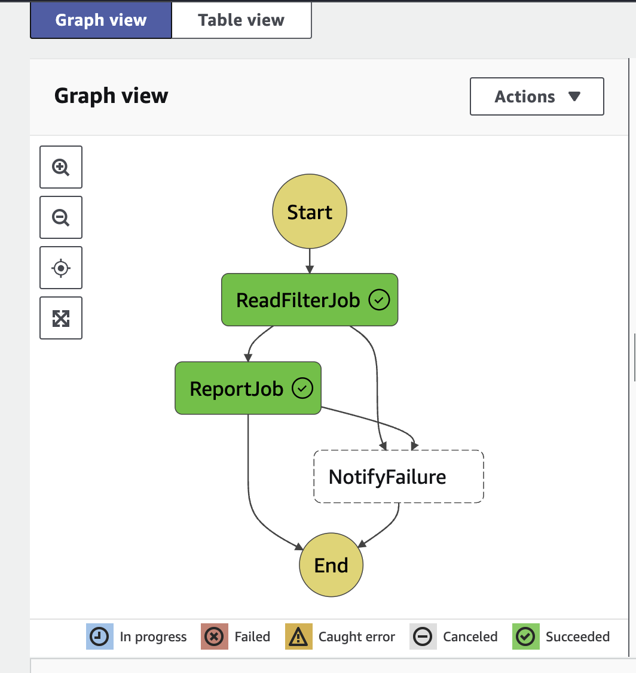
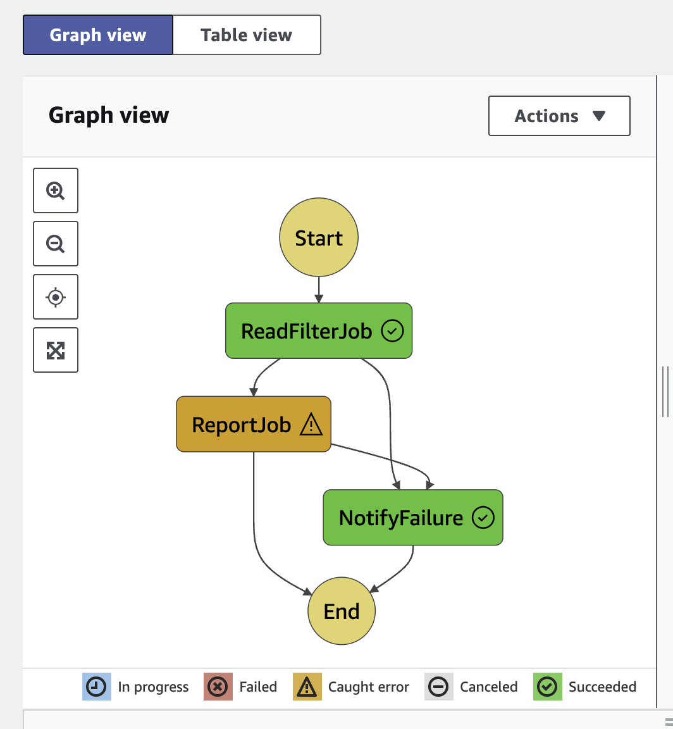
Step Function Screenshots of execution(with error and without error)

